Slide 1

DR. MARTIN LUTHER KING Jr.
ROADWAY & CHANNEL IMPROVEMENTS
PUBLIC MEETING
July 8, 2021 6:30PM

Slide 2
Introductions
Justin Howalt, P.E. City Manager/Engineer
Jay Ashbacher, P.E. Project Engineer
Devin Kennemore Biologist
Team
Lydick Engineers & Surveyors
Civil Transformations
Pathfinder Environmental
North Geo Engineering Services

Slide 3
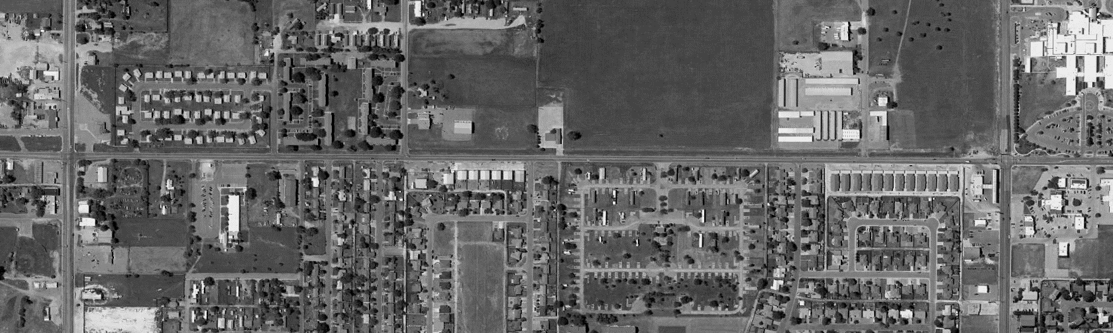
Cesar Chavez
7th ST
21st ST
Dr. Martin Luther King Jr.
Herb
Gary
Debra
Purdue
Elm
Project Limits: W. 7th Street to W. 21st Street
Project Length: Approx. 1 mile
Project Estimate: Approx. $8 million

Slide 4
Cesar Chavez
7th ST
21st ST
Dr. Martin Luther King Jr.
Herb
Gary
Debra
Purdue
Elm
7th St. Intersection: New signals & ADA ramp upgrades
21st St. Intersection: New signals & improved intersection geometry
Cesar Chavez: Crosswalk/school flashers (cantilever mast arm)

Slide 5
Cesar Chavez
7th ST
21st ST
Dr. Martin Luther King Jr.
Herb
Gary
Debra
Purdue
Elm
W. 7th ST W. 21st ST
  Roadway reconstruction and widening
  New sidewalks and bike lanes
  Storm water infrastructure
  Worthington Channel improvements
  Signing, striping and lighting improvements

Slide 6
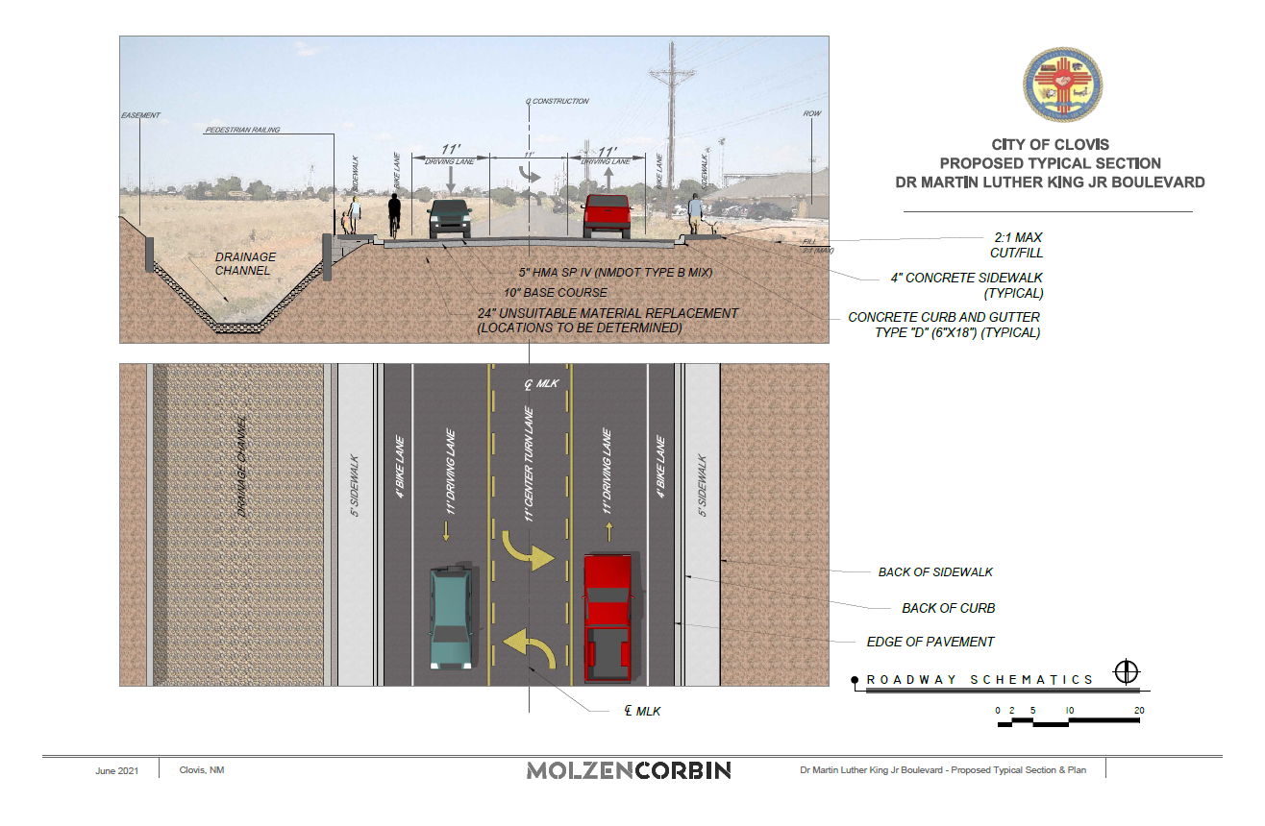

Slide 7
Worthington Channel Improvements
  Concrete lining of the channel
  Full reconstruction of the crossings at Aspen Street , Westgate Street and the Kingdom Hall Church.
  Sidewalk culverts and drop inlet structures will be used to mitigate roadway runoff

Slide 8
Construction Phasing
  1. Worthington Channel lining and construction of the lateral crossings.
  2. Intersection signals and lighting infrastructure.
  3. Roadway and bike/pedestrian facility reconstruction.

Slide 9
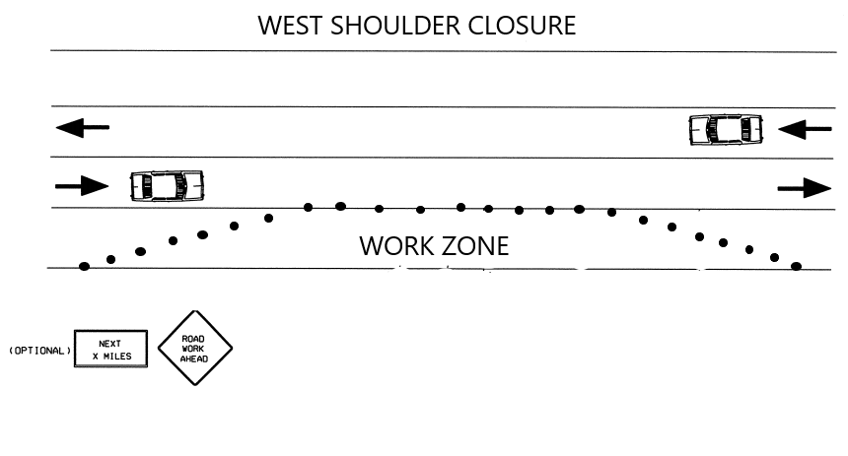
Traffic Control Phase I

Slide 10
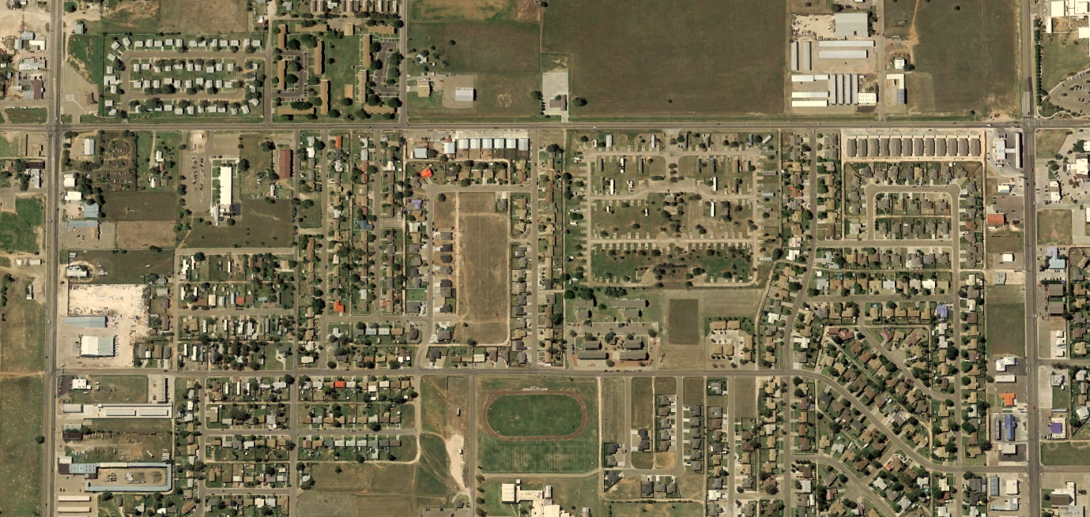
Traffic Control Phase II
Dr. Martin Luther King Jr.
Purdue
7th ST
Debra
21st ST
Elm
Beta
Echols

Slide 11
Traffic Control Phase III
Dr. Martin Luther King Jr.
Purdue
7th ST
Debra
21st ST
Elm
Beta
Echols

Slide 12
Traffic Control Phase IV
Dr. Martin Luther King Jr.
Debra
Purdue
7th ST
Elm
21st ST
Beta
Echols

Slide 13
Traffic Control Phase V
Dr. Martin Luther King Jr.
Debra
Purdue
7th ST
Elm
21st ST
Beta
Echols

Slide 14
Schedule:
Final Design: August 2021
Construction: TBD

Slide 15

Questions/Comments
Comment Forms Available Tonight
Molzen Corbin
505-242-5700 (phone)
jashbacher@molzencorbin.com (email)
Contact: Jay Ashbacher

